Slide 1
What is computer vision?
The search of the fundamental visual features, and the two fundamentals applications of reconstruction and recognition
Features, maps a 2D image into a vector or a point x
Recognition
Reconstruction

Slide 2
2012
The current mania and euphoria of the AI revolution
2012, annual gathering, an improvement of 10% (from 75 to 85)
Computer vision researchers use machine learning techniques to recognize objects in large amount of images
Go back to 1998 (1.5 decade!)
Textual (hand-written and printed) is actually visual!
And why wait for so long?
A silent Hardware revolution: GPU
Sadly driven by video gaming ☺
Nvidia (GPU maker) is now in the driving seat of this AI revolution!
2016, AlphaGo beats professionals
A narrow AI program
Re-shaping AI, Computer Science, digital revolution …
Notes:
1587, a year of no significance, ray huang,
万历15 年， 黄仁宇
China: a macro history
中国大历史

Slide 3
Visual matching, and recognition for understanding
Finding the visually similar things in different images --- Visual similarities
Visual matching, find the ‘same’ thing under different viewpoints, better defined, no semantics per se.
Visual recognition, find the pre-trained ‘labels’, semantics
We define ‘labels’, then ‘learn’ from labeled data, finally classify ‘labels’

Slide 4
The state-of-the-art of visual classification and recognition
Any thing you can clearly define and label
Then show a few thousands examples (labeled data) of this thing to the computer
A computer recognizes a new image, not seen before, now as good as humans, even better!
This is done by deep neural networks.

Slide 5
References
In the notes.pptx, some advanced topics
In talks, some vision history
CNN for Visual Recognition, Stanford http://cs231n.github.io/
Deep Learning Tutorial, LeNet, Montreal http://www.deeplearning.net/tutorial/mlp.html
Deep Learning, Goodfellow, Bengio, and Courville
Pattern Recognition and Machine Learning, Bishop
Sparse and Redundant Representations, Elad
Pattern Recognition and Neural Networks, Ripley
Pattern Classification, Duda, Hart, different editions
A wavelet tour of signal processing, a sparse way, Mallat
Introduction to applied mathematics, Strang
Some figures and texts in the slides are cut/paste from these references.
Notes:
Now the big trends in visual computing are …

Slide 6
A few basics

Slide 7
Vector spaces and geometries
Naturally everything starts from the known vector space
add two vectors
multiply any vector by any scalar
zero vector – origin
finite basis

Slide 8
Vector space to affine: isomorph, one-to-one
vector to Euclidean as an enrichment: scalar prod.
affine to projective as an extension: add ideal elements
Pts, lines, parallelism
Angle, distances, circles
Pts at infinity
Notes:
Affine and eucl are finite geometry in which we are handling only fnite pts

Slide 9
Numerical computation and Linear algebra
Gaussian elimination
LU decomposition
Choleski (sym positive) LL^T
orthogonal decomposition
QR (Gram-Schmidt)
SVD (the high(est)light of linear algebra!)
row space: first Vs
null space: last Vs
col space: first Us
null space of the trans : last Us
Notes:
LU for solving simple linear system,
Instead of inversing the matrix,
It reduces to two triangular system which can be easily computed by forward/backward substitution
QR can solve full-rank least squares
Then if you don’t know the rank, do it with SVD and pseudo-inverse

Slide 10
Applications
solving equations A x = b, decomposition, SVD
less, constraints, sparse solutions
more, least squares solution, ||Ax – b||^2 is eigendecomposition or SVD
solving linear equation, also iteratively nonlinear one f(x), or optimization ||f(x)-g||^2
PCA is SVD
Notes:
this means: g is gradient vector, H is the hessian matrix
jocobien is for squared model, r^T r …

Slide 11
Visual recognition

Slide 12
Image classification and object recognition
Viewing an image as a one dimensional vector of features x, thanks to features! (or simply pixels if you would like),
Image classification and recognition becomes a machine learning application f(x).
What are good features?
Unsupervised, given examples x_i of a random variable x, implicitly or explicitly we learn the distributions p(x), or some properties of p(x)
PCA Principal Components Analysis
K-means clustering
Given a set of training images and labels, we predict labels of a test image.
Supervised, given examples x_i and associated values or labels y_i, we learn to predict a y from a x, usually by estimating p(y|x)
KNN K-Nearest Neighbors
Distance metric and the (hyper) parameter K
Slow by curse of dimension
From linear classifiers to nonlinear neural networks
Notes:
K means clustering is an unsupervised learning, whileas KNN is a supervised learning
Supervised learning: clustering and PCA

Slide 13
Unsupervised
K-means clustering
Partition n data points into k clusters
NP hard
heuristics
PCA Principal Components Analysis
Learns an orthogonal, linear transformation of the data
Notes:
K means clustering is an unsupervised learning, whileas KNN is a supervised learning
Supervised learning: clustering and PCA

Slide 14
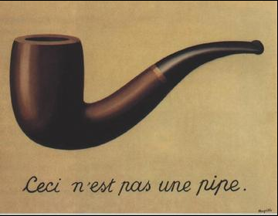
Notes:
K means clustering is an unsupervised learning, whileas KNN is a supervised learning
Supervised learning: clustering and PCA

Slide 15
Supervised
Given a set of training images and labels, we predict labels of a test image.
Supervised learning algorithms
KNN K-Nearest Neighbors
Distance metric and the (hyper) parameter K
Slow by curse of dimension
From linear classifiers to nonlinear neural networks
Notes:
K means clustering is an unsupervised learning, whileas KNN is a supervised learning
Supervised learning: clustering and PCA

Slide 16
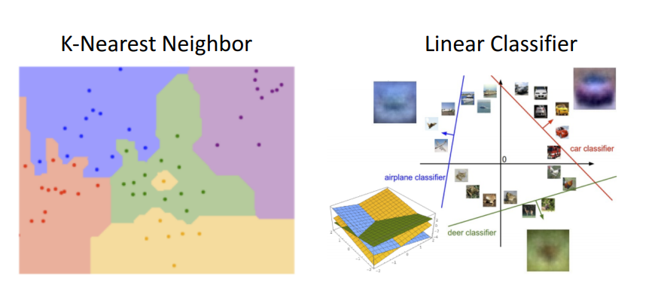
Notes:
K means clustering is an unsupervised learning, whileas KNN is a supervised learning
Supervised learning: clustering and PCA

Slide 17
Fundamental linear classifiers

Slide 18
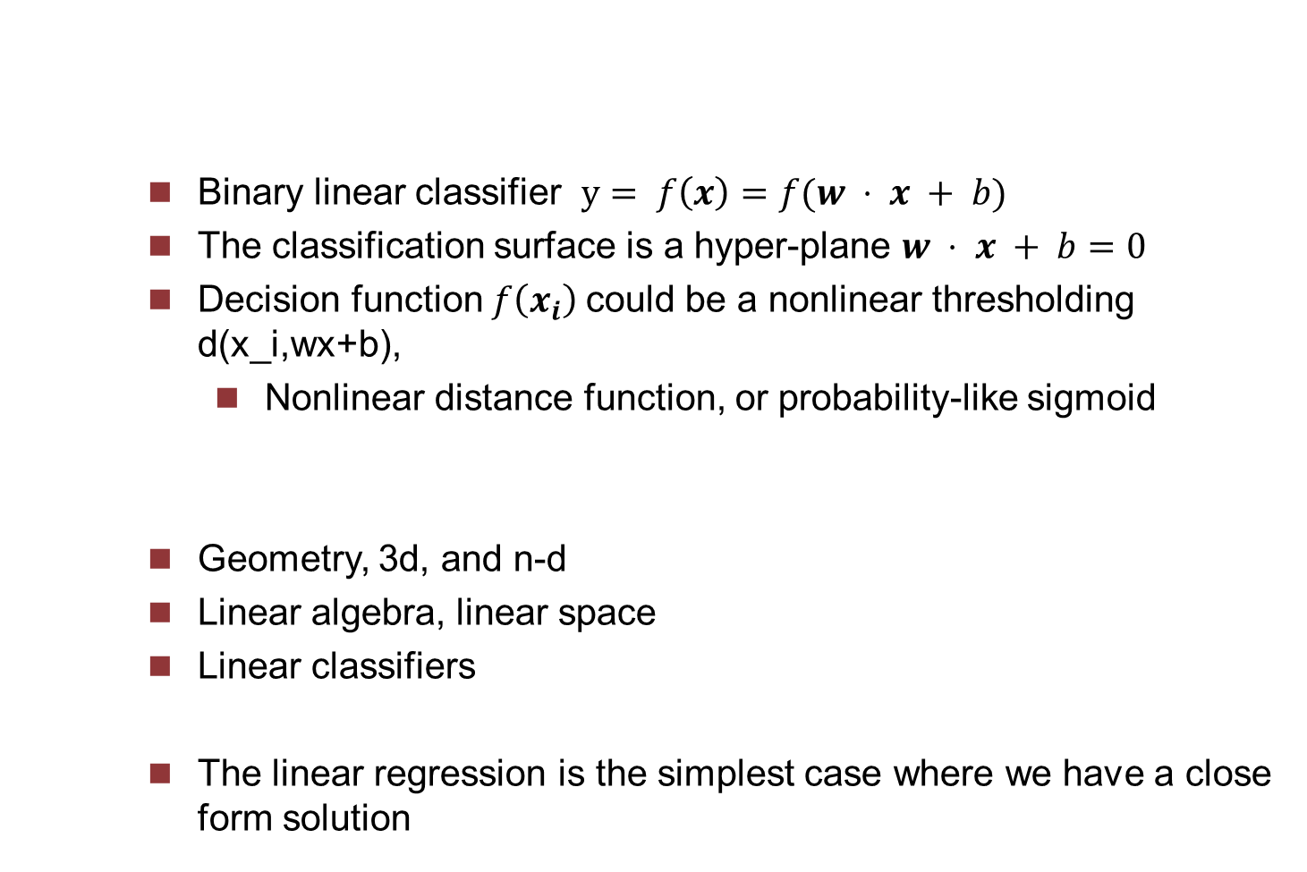
Fundamental binary linear classifiers
Binary linear classifier $y= f\left(x\right)=f(w ⋅ x + b)$
The classification surface is a hyper-plane $w ⋅ x + b=0$
Decision function $f\left(x_{i}\right)$could be a nonlinear thresholding d(x_i,wx+b),
Nonlinear distance function, or probability-like sigmoid
Geometry, 3d, and n-d
Linear algebra, linear space
Linear classifiers
The linear regression is the simplest case where we have a close form solution
Notes:
Can take the nonlinear distance function to the hyperplane, and interpret this distance function as a probability

Slide 19
A neuron is a linear classifier
A single neuron is a linear classifier, where the decision function is the activation function
w x + b, a linear classifier, a neuron,
It’s a dot product of two vectors, scalar product
A template matching, a correlation, the template w and the input vector x (or a matched filter)
Also an algebraic distance, not the geometric one which is non-linear (therefore the solution is usually nonlinear!)
The dot product is the metric distance of two points, one data, the other representative
its angular distance, x . w = ||x|| || w|| cos theta, true distance d = ||x-w||^2 = cosine law = ||x||^2 + ||w||^2- 2 ||x|| ||w|| x . x = x .x + w.w – 2 x.x w.w x . w
The ‘linear’ is that the decision surface is linear, a hyper-plane. The decision function is not linear at all
Notes:
(If take sigmoid as the activation, then a neuron is a binary softmax classifer)
w . x + b > 0 -> w . x > -b, merely a thresholding shift or bias
dot product, the inner product, scalar product, euclidean metric, a distance metric, the example w and the input x, its angular distance, x . w = ||x|| || w|| cos theta, true distance d = ||x-w||^2 = cosine law = ||x||^2 + ||w||^2- 2 ||x|| ||w|| x . x = x .x + w.w – 2 x.x w.w x . w
Dot product, w is a template, or a prototype

Slide 20

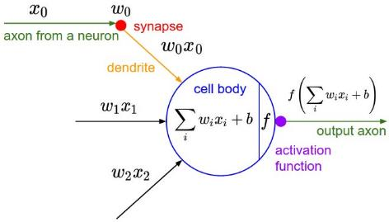
A biological neuron and its mathematical model.

Slide 21
A very simple old example
The chroma-key segmentation, we want to remove the blue or green background in images
Given an image RGB, alpha R + betta G + gamma B > threshold or 0.0 R + 0.0 G + 1.0 B > 100

Slide 22
A linear classifier is not that straightforward
Two things: Inference and Learning
Only inference ‘scoring’ function is linear
We have only one ‘linear’ classifer, but we do have different ways to define the loss to make the learning feasible. The learning is a (nonlinear) optimization problem in which we define a loss function.
Learning is almost never linear!
How to compute or to learn this hyperplane, and how to assess which one is better? To define an objective ‘loss’ function
The classification is ‘discrete’, binary 0, 1,
No ‘analytical’ forms of the loss functions, except the true linear regression with y-y_i
It should be computationally feasible
The logistic regression (though it is a classification, not a regression), converts the output of the linear function into a probability
SVM

Slide 23
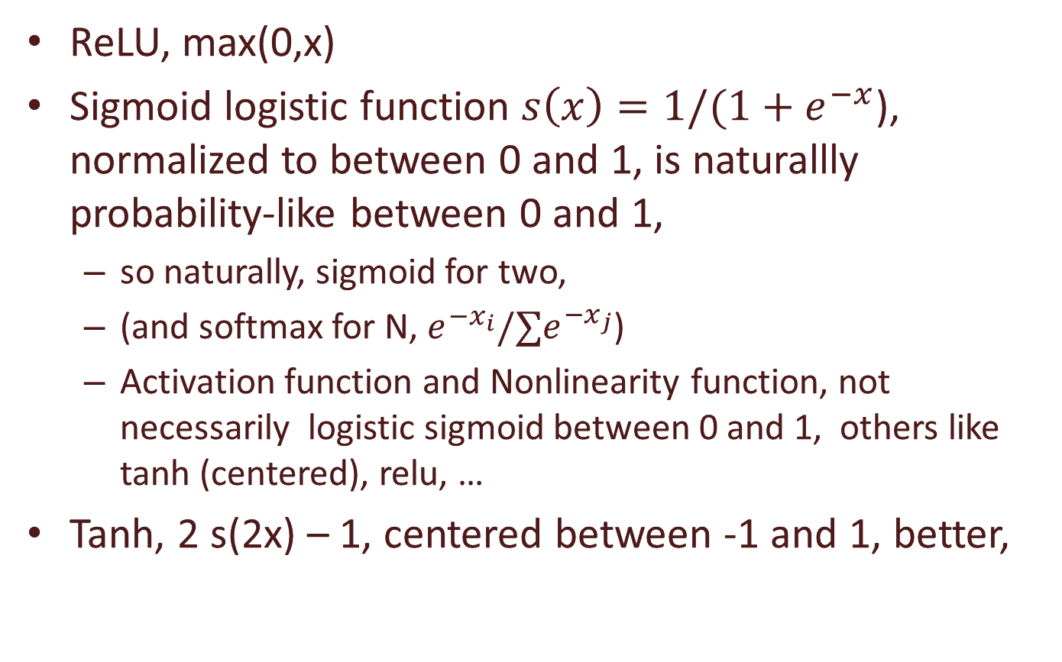
Activation (nonlinearity) functions
ReLU, max(0,x)
Sigmoid logistic function $s\left(x\right)=1/(1+e^{−x}$), normalized to between 0 and 1, is naturallly probability-like between 0 and 1,
so naturally, sigmoid for two,
(and softmax for N, $e^{−x_{i}}{/∑e}^{−x_{j}}$)
Activation function and Nonlinearity function, not necessarily logistic sigmoid between 0 and 1, others like tanh (centered), relu, …
Tanh, 2 s(2x) – 1, centered between -1 and 1, better,
Notes:
Sigmoid, with x1=0, x2=x

Slide 24
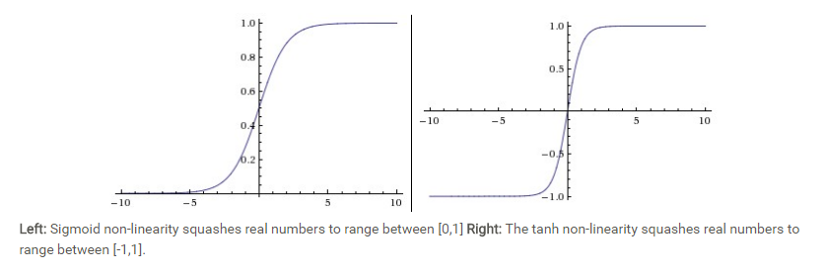
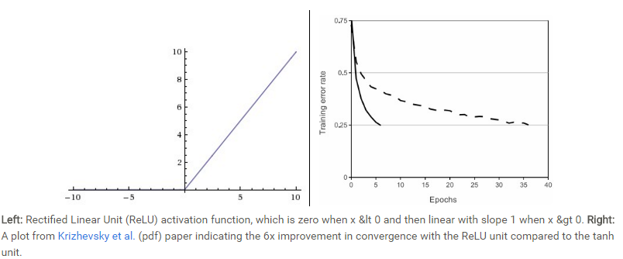

Slide 25
The rectified linear unit, ReLU
The smoother non-linearities used to be favoured in the past.
Sigmoid, kills gradients, not used any more
At present, ReLU is the most popular.
Easy to implement max(0,x)
It learns faster with many layers, accelerates the learning by a factor of 6 (in Alex)
Not smooth at x=0, subderivative is a set for a convex function, left and right derivatives, set to zero for simplicity and sparsity
Notes:
Sigmoid, with x1=0, x2=x

Slide 26
From two to N classes
Classification f : R^n → (1,2,…,n), while Regression f: R^n → R
Multi-class, output a vector function 𝒙′=𝑔(𝑾 𝒙 + 𝒃), where g is the rectified linear.
W x + b, each row is a linear classifier, a neuron

Slide 27
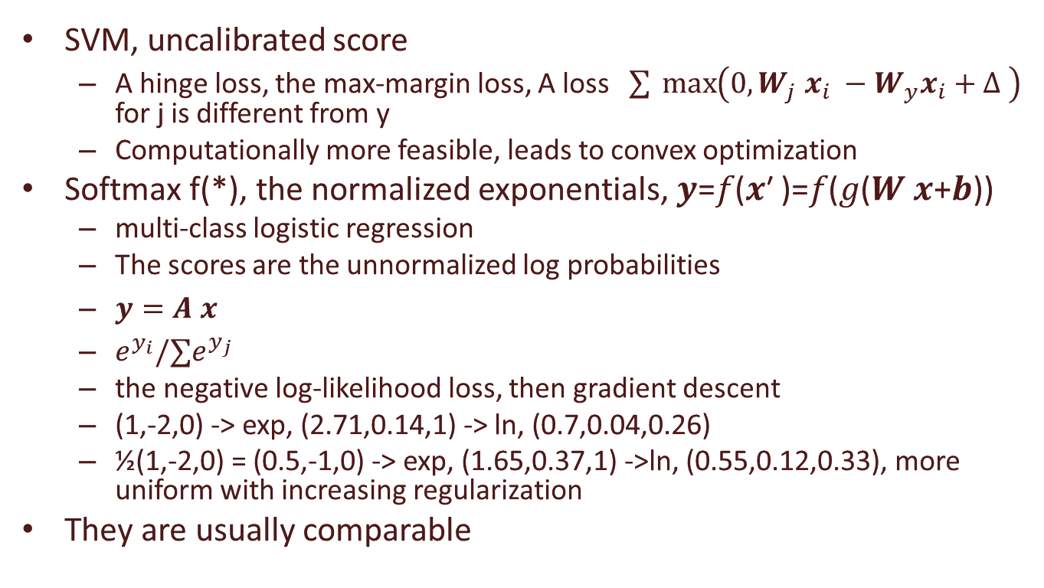
The two common linear classifiers, with different loss functions
SVM, uncalibrated score
A hinge loss, the max-margin loss, A loss $\sum{ \max\left(0,W_{j} x_{i} −W_{y}x_{i}+Δ \right)}$ for j is different from y
Computationally more feasible, leads to convex optimization
Softmax f(*), the normalized exponentials, 𝒚=𝑓(𝒙′ )=𝑓(𝑔(𝑾 𝒙+𝒃))
multi-class logistic regression
The scores are the unnormalized log probabilities
$y=A x$
$e^{y_{i}}{/∑e}^{y_{j}}$
the negative log-likelihood loss, then gradient descent
(1,-2,0) -> exp, (2.71,0.14,1) -> ln, (0.7,0.04,0.26)
½(1,-2,0) = (0.5,-1,0) -> exp, (1.65,0.37,1) ->ln, (0.55,0.12,0.33), more uniform with increasing regularization
They are usually comparable

Slide 28
From linear to non-linear classifiers, Multi Layer Perceptrons
Go higher and linear!
find a map or a transform 𝒙↦𝜙(𝒙) to make them linear, but in higher dimensions
A complete basis of polynomials → too many parameters for the limited training data
Kernel methods, support vector machine, …
Learn the nonlinearity at the same time as the linear classifiers → multilayer neural networks
Notes:
They admit simple algorithms where the form of the nonlinearity can be learned from the training data.
They are extremely powerful, have nice theoretical properties, apply well to a vast array of applications.

Slide 29
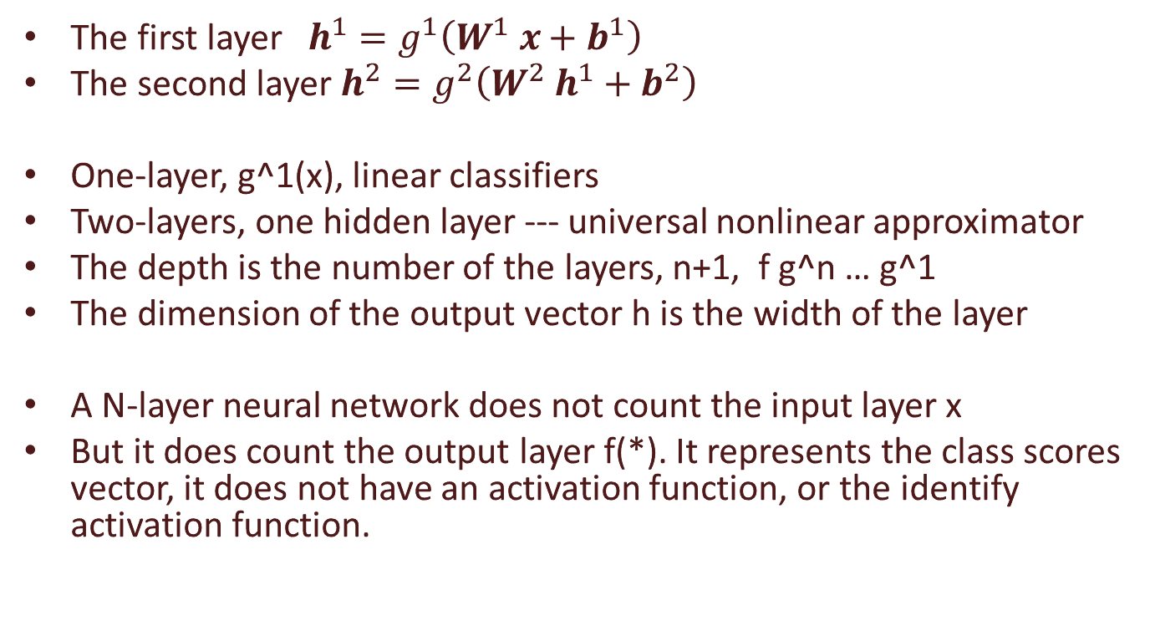
Multi Layer Perceptrons
The first layer $h^{1}=g^{1}\left(W^{1} x+b^{1}\right)$
The second layer $h^{2}=g^{2}\left(W^{2} h^{1}+b^{2}\right)$
One-layer, g^1(x), linear classifiers
Two-layers, one hidden layer --- universal nonlinear approximator
The depth is the number of the layers, n+1, f g^n … g^1
The dimension of the output vector h is the width of the layer
A N-layer neural network does not count the input layer x
But it does count the output layer f(*). It represents the class scores vector, it does not have an activation function, or the identify activation function.
Notes:
Multi layer percetrons is a subclass of neural networks, is the classical type of nn, and is always feedforward nn.
a perceptron is more restrictive, originally.
Mostly, MLP is what we all feedforward neural networks,
Then we have cnn, and rnn …

Slide 30
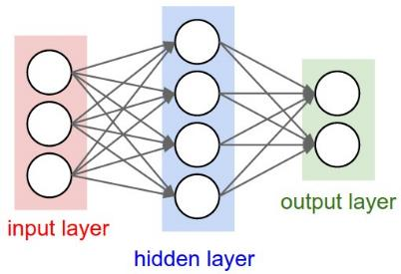
A 2-layer Neural Network, one hidden layer of 4 neurons (or units), and one output layer with 2 neurons, and three inputs.
The network has 4 + 2 = 6 neurons (not counting the inputs), [3 x 4] + [4 x 2] = 20 weights and 4 + 2 = 6 biases, for a total of 26 learnable parameters.

Slide 31
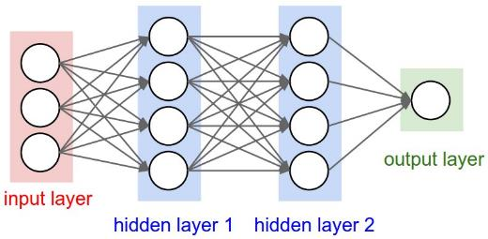
A 3-layer neural network with three inputs, two hidden layers of 4 neurons each and one output layer. Notice that in both cases there are connections (synapses) between neurons across layers, but not within a layer.
The network has 4 + 4 + 1 = 9 neurons, [3 x 4] + [4 x 4] + [4 x 1] = 12 + 16 + 4 = 32 weights and 4 + 4 + 1 = 9 biases, for a total of 41 learnable parameters.

Slide 32
Universal approximator
Given a function, there exisits a feedforward network that approximates the function
A single layer is sufficient to represent any function,
but it may be infeasibly large,
and it may fail to learn and generalize correctly
Using deeper models can reduce the number of units required to represent the function, and can reduce the amount of generalization error

Slide 33
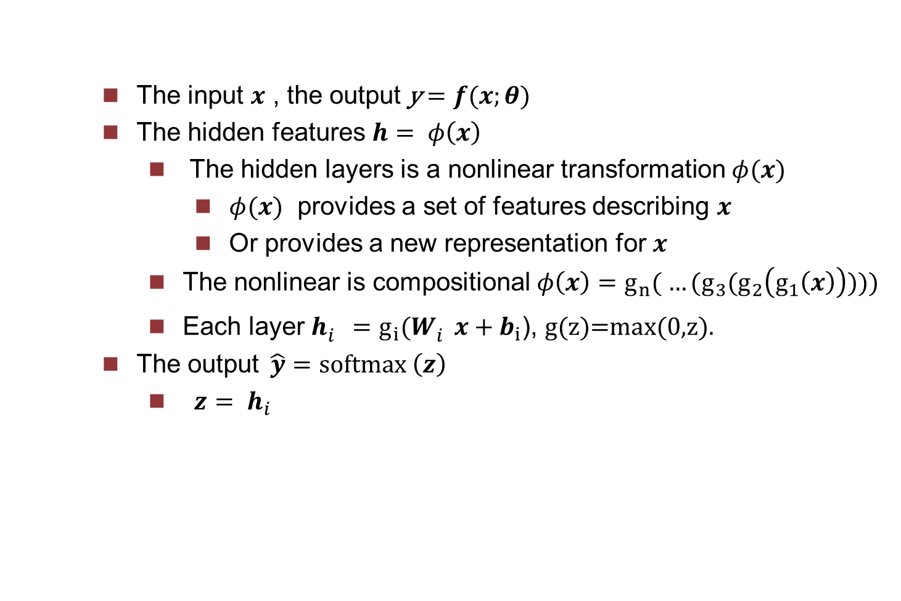
Functional summary
The input $x$ , the output y$=f(x;θ)$
The hidden features $h= φ\left(x\right)$
The hidden layers is a nonlinear transformation $φ(x)$
$φ(x)$ provides a set of features describing $x$
Or provides a new representation for $x$
The nonlinear is compositional $φ\left(x\right)={g_{n}( …(g}_{3}(g_{2}\left(g_{1}\left(x\right)\right))))$
Each layer $h_{i}^{}=g_{i}(W_{i}^{}x+b_{i}$), g(z)=max(0,z).
The output$\hat{y}$ $=softmax \left(z\right)$
$z= h_{i}$

Slide 34
MLP is not new, but deep feedforward neural network is modern!
Feedforward, from x to y, no feedback
Networks, modeled as a directed acyclic grpah for the composition of functions connected in a chain, f(x) = f^(i)( … f^3(f^2(f^1(x))))
The depth of the network is N
‘deep learning’ as N is increasing.

Slide 35
Forward inference f(x) and backward learning \nabla f(x)
A (parameterized) score function f(x,w) mapping the data to class score, forward inference, modeling
A loss function (objective) L measuring the quality of a particular set of parameters based on the ground truth labels
Optimization, minimize the loss over the parameters with a regularization, backward learning
Notes:
Can take the nonlinear distance function to the hyperplane, and interpret this distance function as a probability

Slide 36
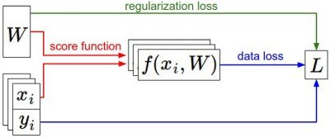
The dataset of pairs of (x,y) is given and fixed. The weights start out as random numbers and can change. During the forward pass the score function computes class scores, stored in vector f. The loss function contains two components: The data loss computes the compatibility between the scores f and the labels y. The regularization loss is only a function of the weights. During Gradient Descent, we compute the gradient on the weights (and optionally on data if we wish) and use them to perform a parameter update during Gradient Descent.

Slide 37
Cost or loss functions
Usually the parametric model f(x,theta) defines a distribution p(y | x; theta) and we use the maximum likelihood, that is the cross-entropy between the training data y and the model’s predictions f(x,theta) as the loss or the cost function.
The cross-entropy between a ‘true’ distribution p and an estimated distribution q is H(p,q) = - \sum_x p(x) log q(x)
The cost J(theta) = - E log p (y|x), if p is normal, we have the mean squared error cost J = ½ E ||y-f(x; theta)||^2+const
The cost can also be viewed as a functional, mapping functions to real numbers, we are learning functions f parameterized by theta. By calculus of variations, f(x) = E_* [y]
The SVM loss is carefully designed and special, hinge loss, max margin loss,
The softmax is the cross-entropy between the estimated class probabilities e^y_i / \sum e and the true class labels, also the negative log likelihood loss L_i = - log (e^y_i / \sum e)

Slide 38
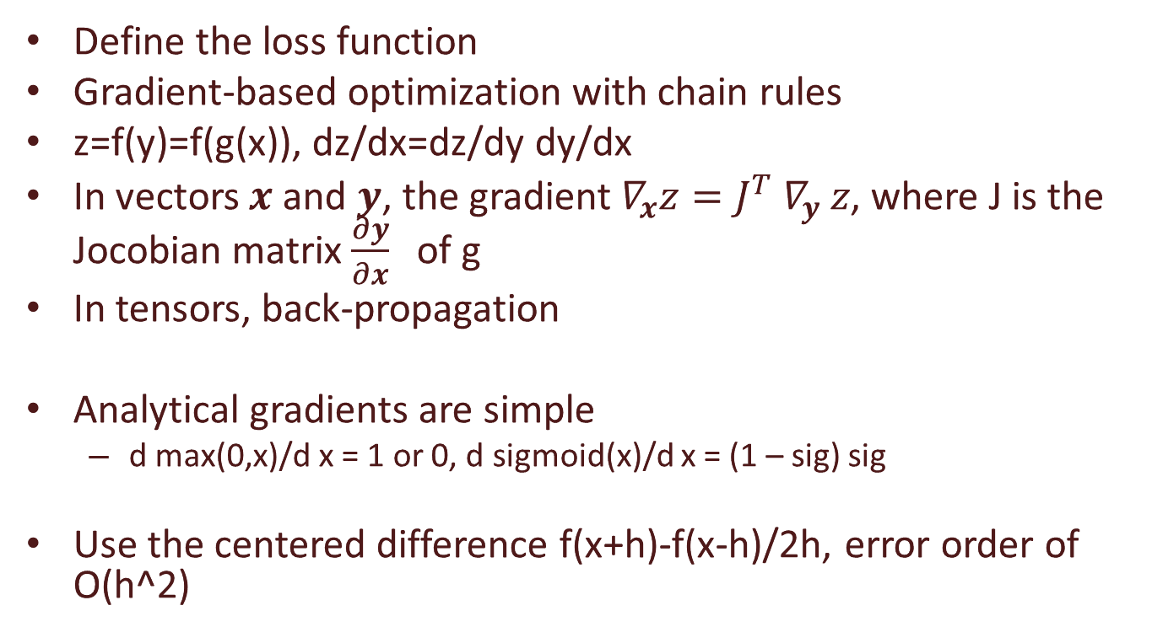
Gradient-based learning
Define the loss function
Gradient-based optimization with chain rules
z=f(y)=f(g(x)), dz/dx=dz/dy dy/dx
In vectors $x$ and $y$, the gradient $∇_{x}z=J^{T} ∇_{y} z$, where J is the Jocobian matrix $\frac{∂y}{∂x}$ of g
In tensors, back-propagation
Analytical gradients are simple
d max(0,x)/d x = 1 or 0, d sigmoid(x)/d x = (1 – sig) sig
Use the centered difference f(x+h)-f(x-h)/2h, error order of O(h^2)
Notes:
Chain rule of calculus, chai rule of probability

Slide 39
Stochastic gradient descent
min loss(f(x;theta)), function of parameters theta, not x
min f(x)
Gradient descent or the method of steepest descent x’ = x - \epsilon \nabla_x f(x)
Gradient descent, follows the gradient of an entire training set downhill
Stochastic gradient descent, follows the gradient of randomly selected minbatches downhill
Notes:
Chain rule of calculus, chai rule of probability

Slide 40
Regularization
loss term + lambda regularization term
Regularization as constraints for underdetermined system
Eg. A^T A + alpha I, Solving linear homogeneous Ax = 0, ||Ax||^2 with ||x||^2=1
Regularization for the stable uniqueness solution of ill-posed problems (no unique solution)
Regularization as prior for MAP on top of the maximum likelihood estimation, again all approximations to the full Bayesian inference
L1/2 regularization
L1 regularization has ‘feature selection’ property, that is, it produces a sparse vector, setting many to zeros
L2 is usually diffuse, producing small numbers.
L2 superior is not explicitly selecting features
Notes:
The expansion of log p typically yields some terms that do not depend on the model parameters and may be discarded. If p is normal, then we recover the mean squred error cost, J = E || y – f (x, theta) ||^2 + c, up to a scaling factor and a term that does not depend on theta.

Slide 41
Hyperparameters and validation
The hyper-parameter lambda
Split the training data into two disjoint subsets
One is to learn the parameters
The other subset, the validation set, is to guide the selection of the hyperparameters
Notes:
The expansion of log p typically yields some terms that do not depend on the model parameters and may be discarded. If p is normal, then we recover the mean squred error cost, J = E || y – f (x, theta) ||^2 + c, up to a scaling factor and a term that does not depend on theta.

Slide 42
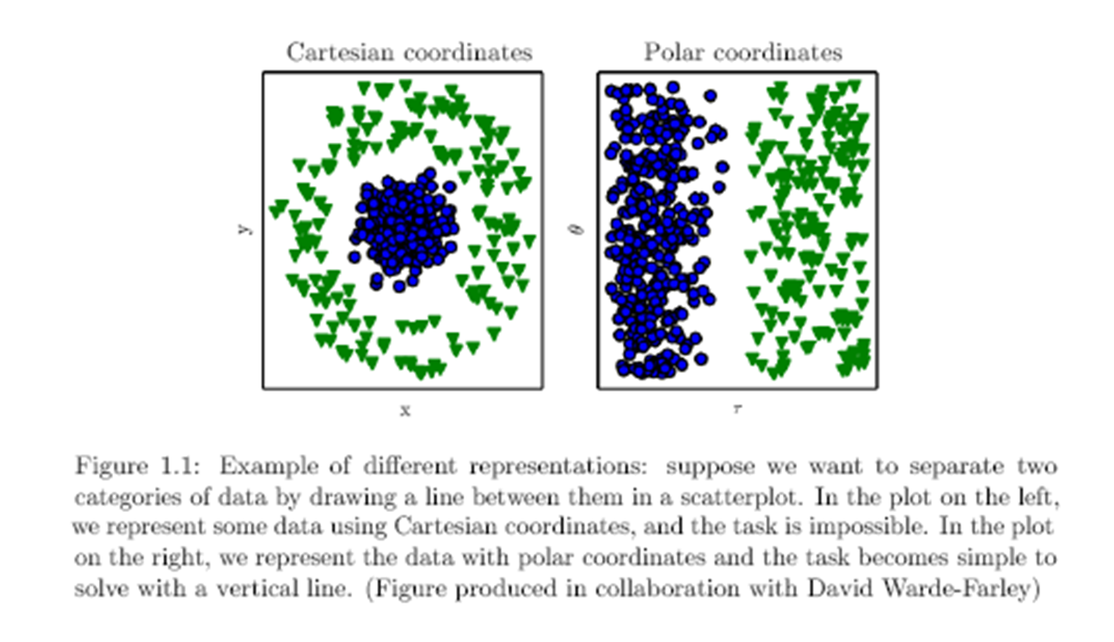
A linearly separable toy example
The toy spiral data consists of three classes (blue, red, yellow) that are not linearly separable.
300 pts, 3 classes
Linear classifier fails to learn the toy spiral dataset.
Neural Network classifier crushes the spiral dataset.
One hidden layer of width 100
Notes:
Chain rule of calculus, chai rule of probability

Slide 43
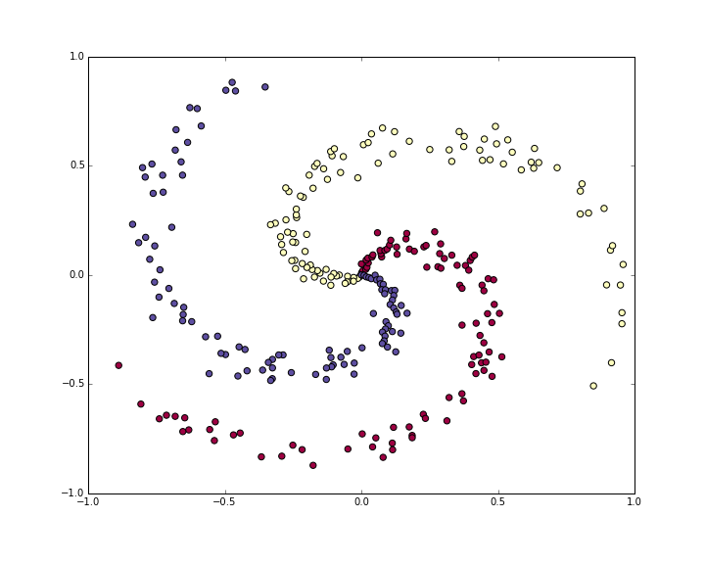
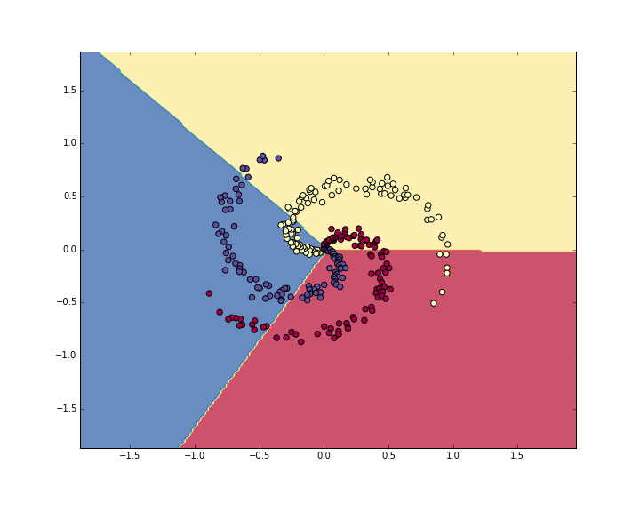
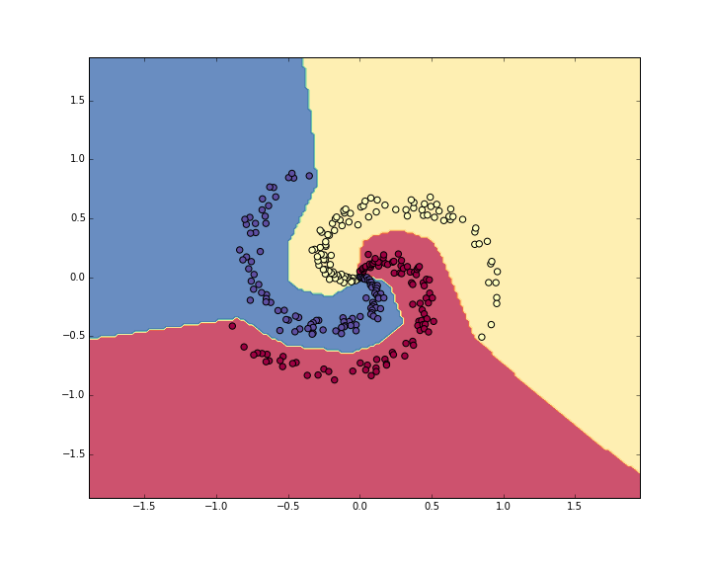
A toy example from cn231n
The toy spiral data consists of three classes (blue, red, yellow) that are not linearly separable.
3 classes, 100 pts for each class
Softmax linear classifier fails to learn the toy spiral dataset.
One layer, W, 2*3, b,
analytical gradients, 190 iteration, loss from 1.09 to 0.78, 48% training set accuracy
Neural Network classifier crushes the spiral dataset.
One hidden layer of width 100, W1, 2*100, b1, W2, 100*3, only few extra lines of python codes!
9000 iteration, loss from 1.09 to 0.24, 98% training set accuracy

Slide 44
Generalization
The ‘optimization’ reduces the training errors (or residual errors before)
The ‘machine learning’ wants to reduce the generalization error or the test error as well.
The generalization error is the expected value of the error on a new input, from the test set.
Make the training error small.
Make the gap between training and test error small.
Underfitting is not able to have sufficiently low error on the training set
Overfitting is not able to narrow the gap between the training and the test error.
Notes:
The expansion of log p typically yields some terms that do not depend on the model parameters and may be discarded. If p is normal, then we recover the mean squred error cost, J = E || y – f (x, theta) ||^2 + c, up to a scaling factor and a term that does not depend on theta.

Slide 45
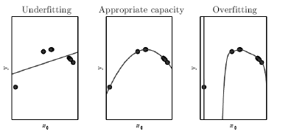
The training data was generated synthetically, by randomly sampling x values and choosing y deterministically
by evaluating a quadratic function. (Left) A linear function fit to the data suffers from
underfitting. (Center) A quadratic function fit to the data generalizes well to unseen points. It does not suffer from
a significant amount of overfitting or underfitting. (Right) A polynomial of degree 9 fit to
the data suffers from overfitting. Here we used the Moore-Penrose pseudoinverse to solve
the underdetermined normal equations. The solution passes through all of the training
points exactly, but we have not been lucky enough for it to extract the correct structure.
Notes:
The expansion of log p typically yields some terms that do not depend on the model parameters and may be discarded. If p is normal, then we recover the mean squred error cost, J = E || y – f (x, theta) ||^2 + c, up to a scaling factor and a term that does not depend on theta.

Slide 46
The capacity of a model
The old Occam’s razor. Among competing ones, we should choose the “simplest” one.
The modern VC Vapnik-Chervonenkis dimension. The largest possible value of m for which there exists a training set of m different x points that the binary classifier can label arbitrarily.
The no-free lunch theorem. No best learning algorithms, no best form of regularization. Task specific.
Notes:
The expansion of log p typically yields some terms that do not depend on the model parameters and may be discarded. If p is normal, then we recover the mean squred error cost, J = E || y – f (x, theta) ||^2 + c, up to a scaling factor and a term that does not depend on theta.

Slide 47

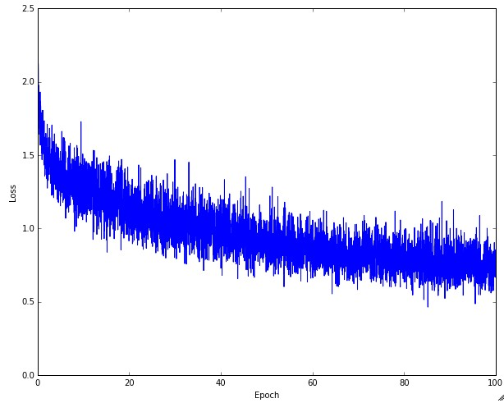
Practice: learning rate
Left: A cartoon depicting the effects of different learning rates. With low learning rates the improvements will be linear. With high learning rates they will start to look more exponential. Higher learning rates will decay the loss faster, but they get stuck at worse values of loss (green line). This is because there is too much "energy" in the optimization and the parameters are bouncing around chaotically, unable to settle in a nice spot in the optimization landscape. Right: An example of a typical loss function over time, while training a small network on CIFAR-10 dataset. This loss function looks reasonable (it might indicate a slightly too small learning rate based on its speed of decay, but it's hard to say), and also indicates that the batch size might be a little too low (since the cost is a little too noisy).

Slide 48
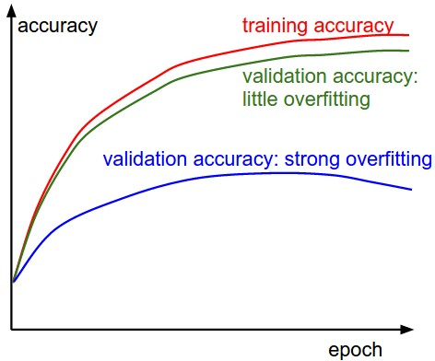
Practice: avoid overfitting
The gap between the training and validation accuracy indicates the amount of overfitting. Two possible cases are shown in the diagram on the left. The blue validation error curve shows very small validation accuracy compared to the training accuracy, indicating strong overfitting. When you see this in practice you probably want to increase regularization or collect more data. The other possible case is when the validation accuracy tracks the training accuracy fairly well. This case indicates that your model capacity is not high enough: make the model larger by increasing the number of parameters.

Slide 49
Why deeper?
Deeper networks are able to use far fewer units per layer and far fewer parameters, as well as frequently generalizing to the test set
But harder to optimize!
Choosing a deep model encodes a very general belief that the function we want to learn involves composition of several simpler functions. Or the learning consists of discovering a set of underlying factors of variation that can in turn be described in terms of other, simpler underlying factors of variation.

Slide 50
Curse of dimensionality
The core idea in deep learning is that we assume that the data was generated by the composition factors or features, potentially at multiple levels in a hierarchy.
This assumption allows an exponential gain in the relationship between the number of examples and the number of regions that can be distinguished.
The exponential advantages conferred by the use of deep, distributed representations counter the exponential challenges posed by the curse of dimensionality.

Slide 51
Convolutional Neural Networks, or CNN, a visual network, and back to a 2D lattice from the abstraction of the 1D feature vector x in neural networks

Slide 52
From a regular network to CNN
We have regarded an input image as a vector of features, x, by virtue of feature detection and selection, like other machine learning applications to learn f(x)
We now regard it as is, a 2D image, a 2D grid, a topological discrete lattice, I(I,j)
Converting input images into feature vector loses the spatial neighborhood-ness
complexity increases to cubics
Yet, the connectivities become local to reduce the complexity!

Slide 53
What is a convolution?
The fundamental operation, the convolution I * K(I,j) = \sum \sum
Flipping kernels makes the convolution commutative, which is fundamental in theory, but not required in NN to compose with other functions, so to include discrete correlations as well into “convolution”
Convolution is a linear operator, dot-product like correlation, not a matrix multiplication, but can be implemented as a sparse matrix multiplication, to be viewed as an affine transform

Slide 54
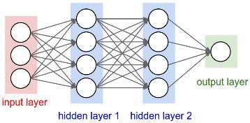
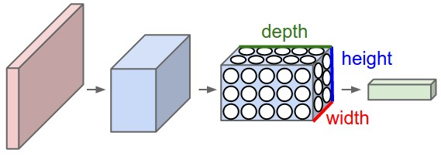
A regular 3-layer Neural Network.
A CNN arranges its neurons in three dimensions (width, height, depth). Every layer of a CNN transforms the 3D input volume to a 3D output volume. In this example, the red input layer holds the image, so its width and height would be the dimensions of the image, and the depth would be 3 (Red, Green, Blue channels).

Slide 55
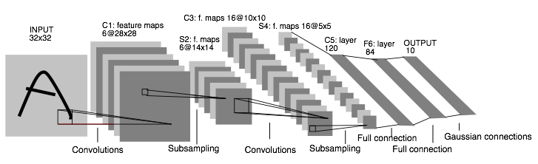
Convolutional Neural Networks: 1998. Input 32*32. CPU
LeNet: a layered model composed of convolution and subsampling operations followed by a holistic representation and ultimately a classifier for handwritten digits. [ LeNet ]

Slide 56
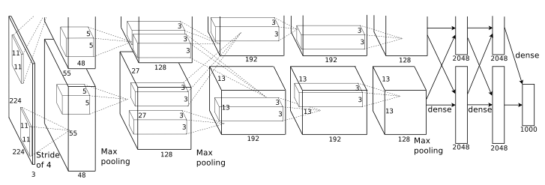
Convolutional Neural Networks: 2012. Input 224*224*3. GPU.
AlexNet: a layered model composed of convolution, subsampling, and further operations followed by a holistic representation and all-in-all a landmark classifier on
ILSVRC12. [ AlexNet ]
+ data
+ gpu
+ non-saturating nonlinearity
+ regularization

Slide 57
LeNet vs AlexNet
32*32*1
7 layers
2 conv and 4 classification
60 thousand parameters
Only two complete convolutional layers
Conv, nonlinearities, and pooling as one complete layer
224*224*3
8 layers
5 conv and 3 fully classification
5 convolutional layers, and 3,4,5 stacked on top of each other
Three complete conv layers
60 million parameters, insufficient data
Data augmentation:
Patches (224 from 256 input), translations, reflections
PCA, simulate changes in intensity and colors

Slide 58
The motivation of convolutions
Sparse interaction, or Local connectivity.
The receptive field of the neuron, or the filter size.
The connections are local in space (width and height), but always full in depth
A set of learnable filters
Parameters sharing, the weights are tied
Equivariant representation, translation invariant

Slide 59
Convolution and matrix multiplication
Discrete convolution can be viewed as multiplication by matrix
The kernel is a doubly block circulant matrix
It is very sparse!

Slide 60
The ‘convolution’ operation
The convolution is commutative because we have flipped the kernel
Many implement a cross-correlation without flipping
A convolution can be defined for 1, 2, 3, and N D
The 2D convolution is different from a real 3D convolution, which integrates the spatio-temporal information, the standard CNN convolution has only ‘spatial’ spreading
In CNN, even for 3D RGB input images, the standard convolution is 2D in each channel,
each channel has a different filter or kernel, the convolution per channel is then summed up in all channels to produce a scalar for non-linearity activation
The filiter in each channel is not normalized, so no need to have different linear combination coefficients.
1*1 convolution is a dot product in different channel, a linear combination of different chanels
The backward pass of a convolution is also a convolution with spatially flipped filters.

Slide 61
The convolution layers
Stacking several small convolution layers is different from convolution cascating
As each small convolution is followed by the nonlinearities ReLU
The nonlinearities make the features more expressive!
Have fewer parameters with small filters, but more memory.
Cascating simply enlarges the spatial extent, the receptive field
Whether each conv layer is also followed by a pooling?
Lenet does not!
AlexNet first did not.

Slide 62
The Pooling Layer
Reduce the spatial size
Reduce the amount of parameters
Avoid over-fitting
Backpropagation for a max: only routing the gradient to the input that had the highest value in the forward pass
It is unclear whether the pooling is essential.

Slide 63
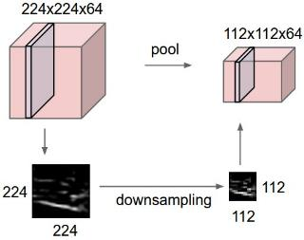
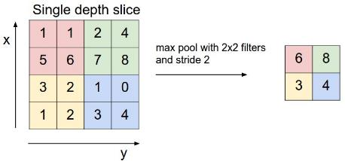
Pooling layer down-samples the volume spatially, independently in each depth slice of the input volume.
Left: the input volume of size [224x224x64] is pooled with filter size 2, stride 2 into output volume of size [112x112x64]. Notice that the volume depth is preserved.
Right: The most common down-sampling operation is max, giving rise to max pooling, here shown with a stride of 2. That is, each max is taken over 4 numbers (little 2x2 square).

Slide 64
The spatial hyperparameters
Depth
Stride
Zero-padding

Slide 65
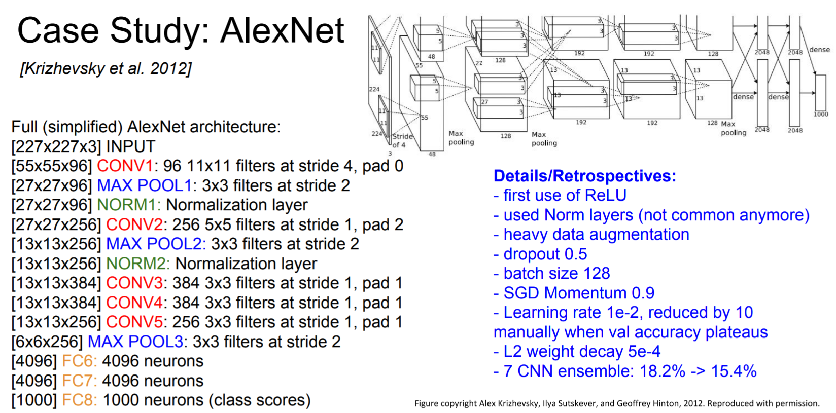
AlexNet 2012
A strong prior has very low entropy, e.g. a Gaussian with low variance
An infinitely strong prior says that some parameters are forbidden, and places zero probability on them
The convolution ‘prior’ says the identical and zero weights
The pooling forces the invariance of small translations

Slide 66
The convolution and pooling act as an infinitely strong prior!
A strong prior has very low entropy, e.g. a Gaussian with low variance
An infinitely strong prior says that some parameters are forbidden, and places zero probability on them
The convolution ‘prior’ says the identical and zero weights
The pooling forces the invariance of small translations

Slide 67
The neuroscientific basis for CNN
The primary visual cortex, V1, about which we know the most
The brain region LGN, lateral geniculate nucleus, at the back of the head carries the signal from the eye to V1, a convolutional layer captures three aspects of V1
It has a 2-dimensional structure
V1 contains many simple cells, linear units
V1 has many complex cells, corresponding to features with shift invariance, similar to pooling
When viewing an object, info flows from the retina, through LGN, to V1, then onward to V2, then V4, then IT, inferotemporal cortex, corresponding to the last layer of CNN features
Not modeled at all. The mammalian vision system develops an attention mechanism
The human eye is mostly very low resolution, except for a tiny patch fovea.
The human brain makes several eye movements saccades to salient parts of the scene
The human vision perceives 3D
A simple cell responds to a specific spatial frequency of brightness in a specific direction at a specific location --- Gabor-like functions

Slide 68
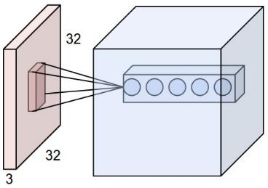
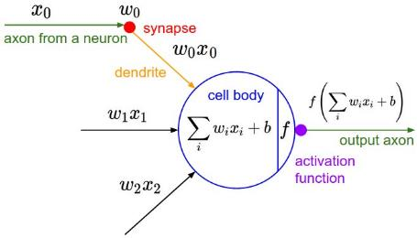
Receptive field
Left: An example input volume in red (e.g. a 32x32x3 CIFAR-10 image), and an example volume of neurons in the first Convolutional layer. Each neuron in the convolutional layer is connected only to a local region in the input volume spatially, but to the full depth (i.e. all color channels). Note, there are multiple neurons (5 in this example) along the depth, all looking at the same region in the input - see discussion of depth columns in text below. Right: The neurons from the Neural Network chapter remain unchanged: They still compute a dot product of their weights with the input followed by a non-linearity, but their connectivity is now restricted to be local spatially.

Slide 69
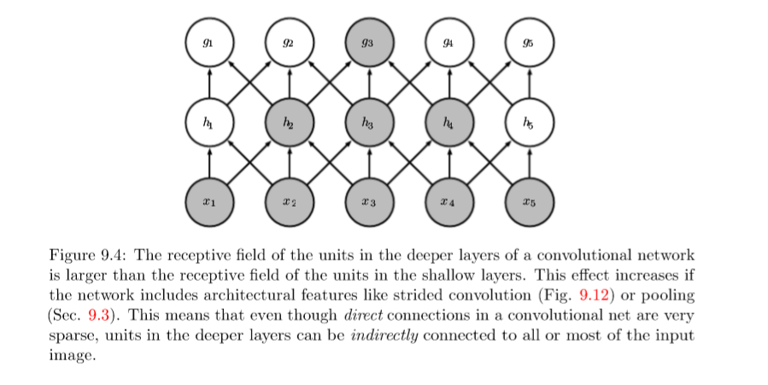
Receptive field

Slide 70
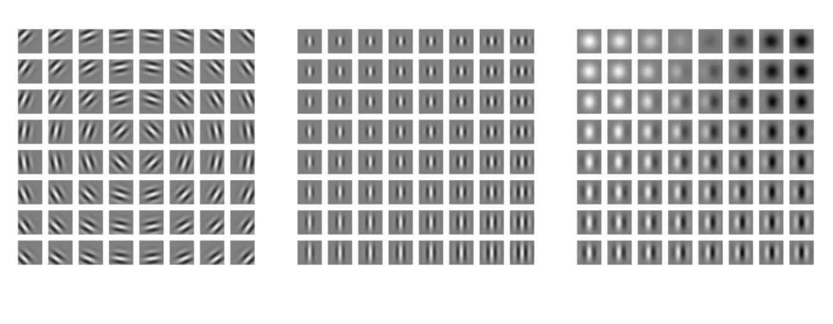
Gabor functions

Slide 71
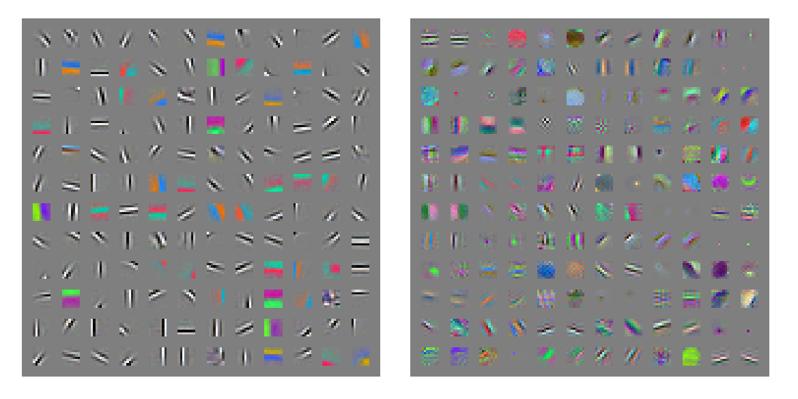
Gabor-like learned features

Slide 72
CNN architectures and algorithms

Slide 73
CNN architectures
The conventional linear structure, linear list of layers, feedforward
Generally a DAG, directed acyclic graph
ResNet simply adds back
Different terminology: complex layer and simple layer
A complex (complete) convolutional layer, including different stages such as convolution per se, batch normalization, nonlinearity, and pooling
Each stage is a layer, even there are no parameters
The traditional CNNs are just a few complex convolutional layers to extract features, then are followed by a softmax classification output layer
Convolutional networks output a high-dimensional, structured object, rather than just predicting a class label for a classiciation task or a real valuefor a regression task, it it an output tensor
S_i,j,k is the probability that pixel j,k belongs to class I
Notes:
http://cs231n.github.io/neural-networks-1/

Slide 74
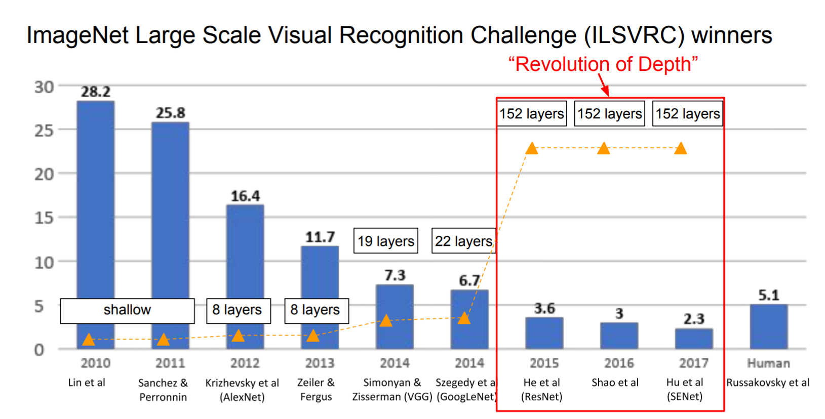
The popular CNN
LeNet, 1998
AlexNet, 2012
VGGNet, 2014
ResNet, 2015
Notes:
http://cs231n.github.io/neural-networks-1/

Slide 75
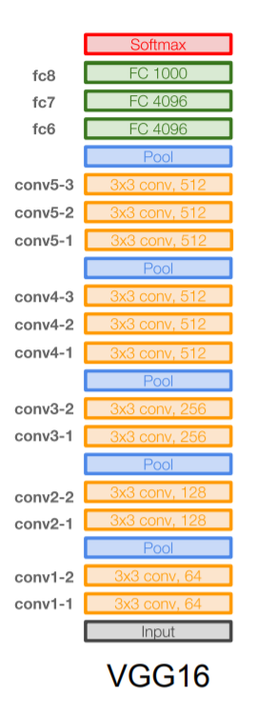
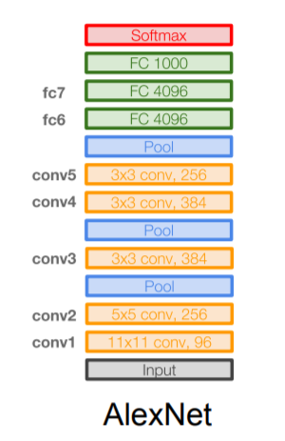
VGGNet
16 layers
Only 3*3 convolutions
138 million parameters

Slide 76
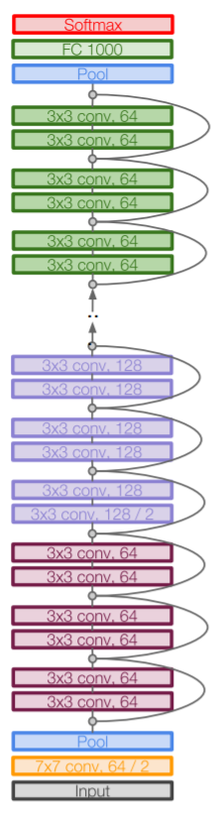
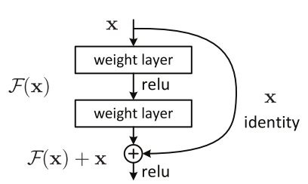
ResNet
152 layers
ResNet50

Slide 77
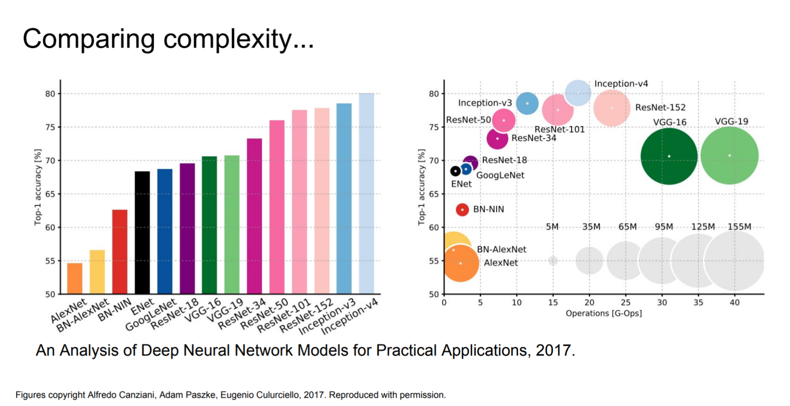
Computational complexity
The memory bottleneck
GPU, a few GB

Slide 78
Stochastic Gradient Descent
Gradient descent, follows the gradient of an entire training set downhill
Stochastic gradient descent, follows the gradient of randomly selected minbatches downhill

Slide 79
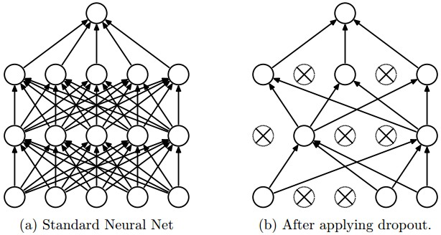
The dropout regularization
Randomly shutdown a subset of units in training
It is a sparse representation
It is a different net each time, but all nets share the parameters
A net with n units can be seen as a collection of 2^n possible thinned nets, all of which share weights.
At test time, it is a single net with averaging
Avoid over-fitting

Slide 80
Ensemble methods
Bagging (bootstrap aggregating), model averaging, ensemble methods
Model averaging outperforms, with increased computation and memory
Model averaging is discouraged when benchmarking for publications
Boosting, an ensemble method, constructs an ensemble with higher capacity than the individual models

Slide 81
Batch normalization
After convolution, before nonlinearity
‘Batch’ as it is done for a subset of data
Instead of 0-1 (zero mean unit variance) input, the distribution will be learnt, even undone if necessary
The data normalization or PCA/whitening is common in general NN, but in CNN, the ‘normalization layer’ has been shown to be minimal in some nets as well.

Slide 82
Open questions
Networks are non-convex
Need regularization
Smaller networks are hard to train with local methods
Local minima are bad, in loss, not stable, large variance
Bigger ones are easier
More local minima, but better, more stable, small variance
As big as the computational power, and data!

Slide 83
Local minima, saddle points, and plateaus?
We don’t care about finding the exact mimimum, we only want to obtain good generalization error by reducing the function value.
In low-dimensional, local minima are common.
In higher dimensional, local minima are rare, and saddle points are more common.
The Hessian at a local mimimum has all positive eigenvalues. The Hessian at a saddle point has a micture of pos and neg eigenvalues.
It is exponentially unlikely that all n will have the same sign in high n-dim

Slide 84
CNN applications

Slide 85
CNN applications
Transfer learning
Fine-tuning the CNN
Keep some early layers
Early layers contain more generic features, edges, color blobs
Common to many visual tasks
Fine-tune the later layers
More specific to the details of the class
CNN as feature extractor
Remove the last fully connected layer
A kind of descriptor or CNN codes for the image
AlexNet gives a 4096 Dim descriptor
Notes:
http://cs231n.github.io/neural-networks-1/

Slide 86
CNN classification/recognition nets
CNN layers and fully-connected classification layers
From ResNet to DenseNet
Densely connected
Feature concatenation
Notes:
http://cs231n.github.io/neural-networks-1/

Slide 87
Fully convolutional nets: semantic segmentation
Classification/recognition nets produce ‘non-spatial’ outputs
the last fully connected layer has the fixed dimension of classes, throws away spatial coordinates
Fully convolutional nets output maps as well
Notes:
http://cs231n.github.io/neural-networks-1/

Slide 88
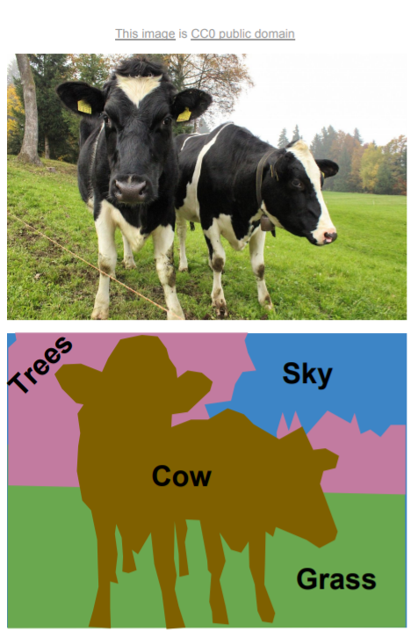
Semantic segmentation

Slide 89
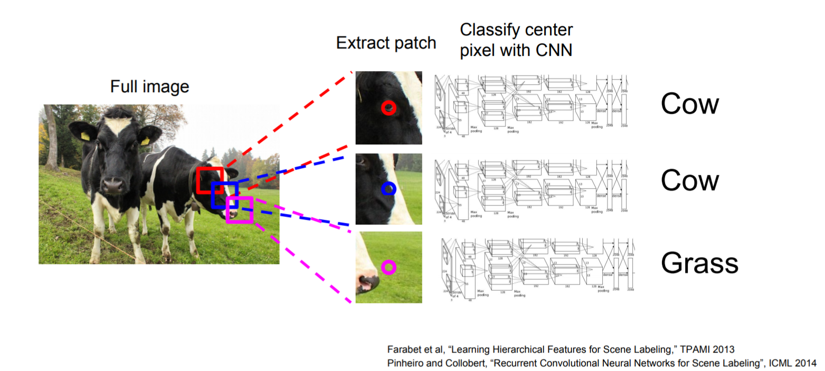
Using sliding windows for semantic segmentation

Slide 90
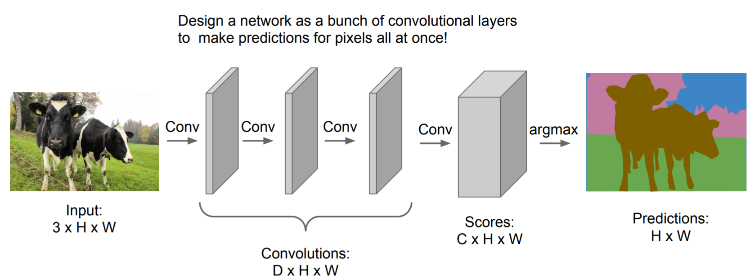
Fully convolutional

Slide 91
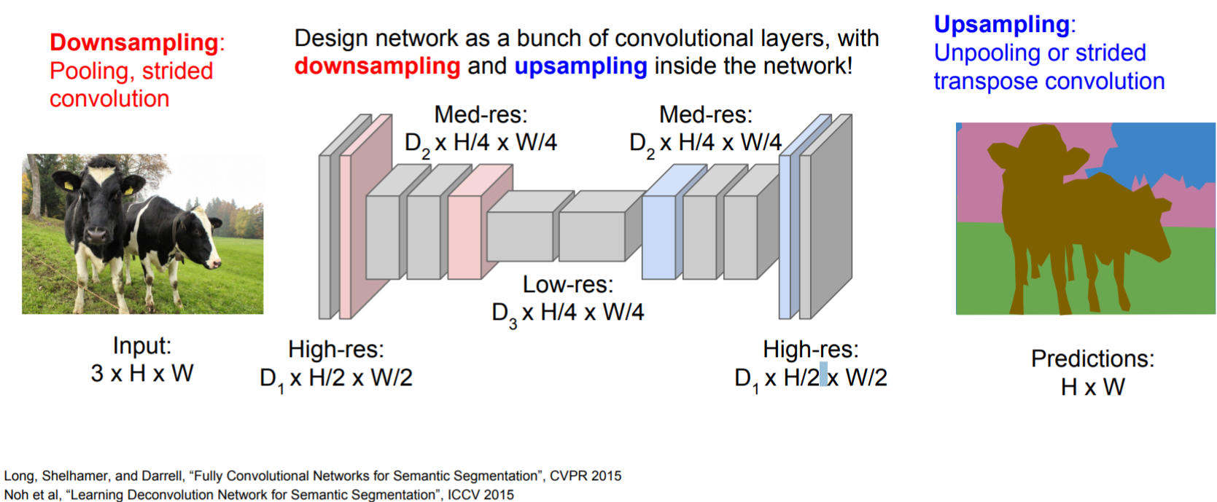
Fully convolutional

Slide 92
Detection and segmentation nets: The Mask Region-based CNN (R-CNN):
Class-independent region (bounding box) proposals
From selective search to region proposal net with objectness
Use CNN to class each region
Regression on the bounding box or contour segmentation
Mask R-CNN: end-to-end
Use CNN to make proposals on object/non-object in parallel
The old good idea of face detection by Viola
Proposal generation
Cascading (ada boosting)
Notes:
HOG features, Histogram of Gradients, by Triggs

Slide 93
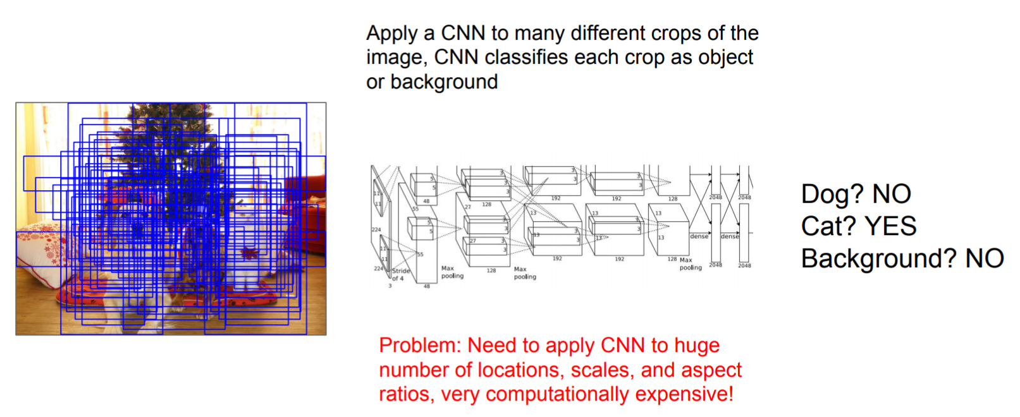
Using sliding windows for object detection as classification

Slide 94
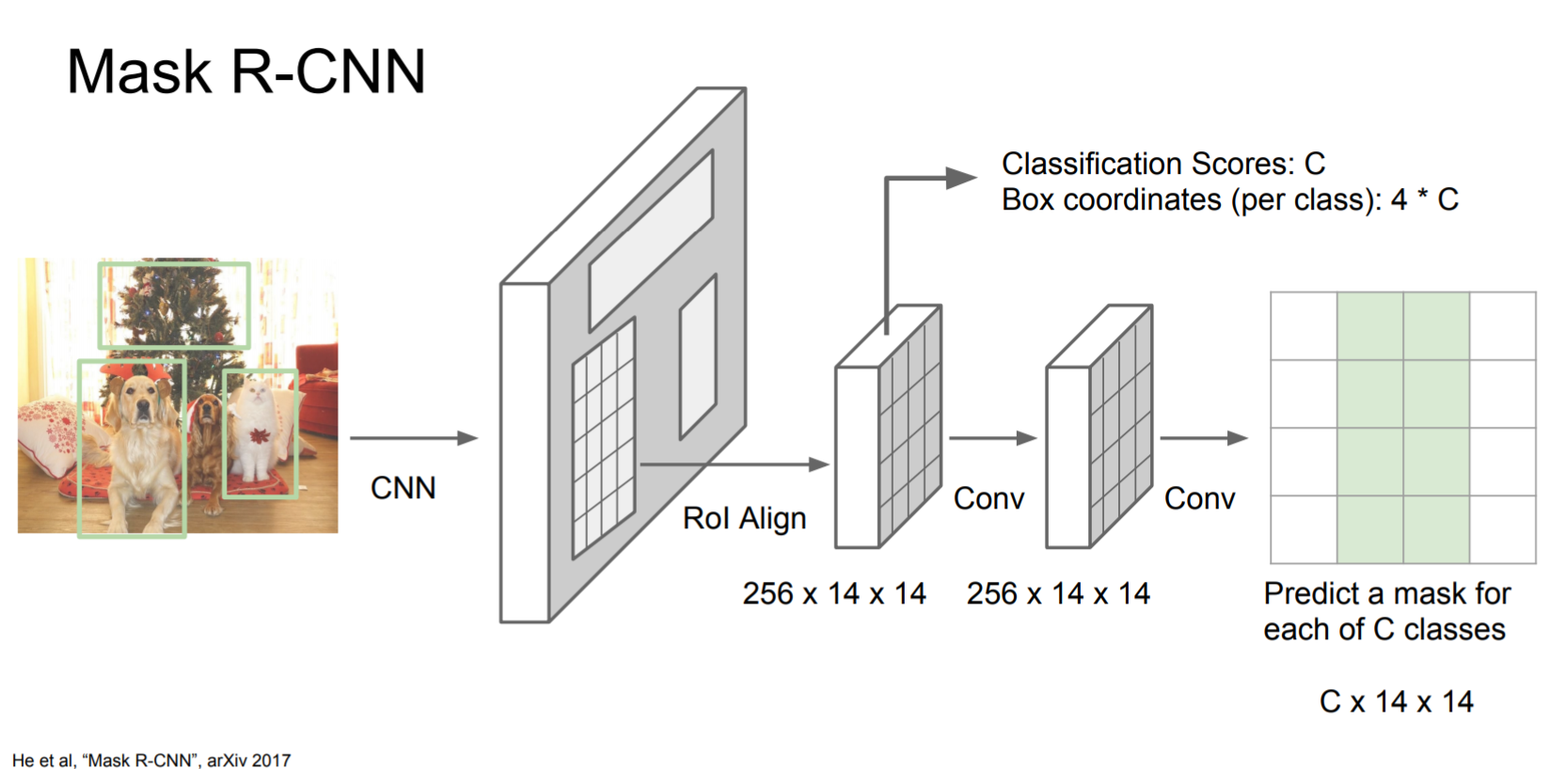
Mask R-CNN

Slide 95
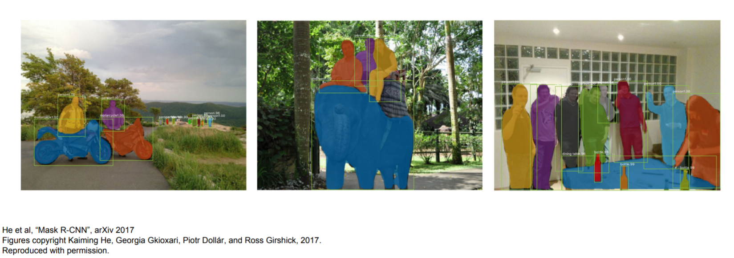
Excellent results

Slide 96
End.

Slide 97
Some old notes in 2017 and 2018

Slide 98
Fundamentally from continuous to discrete views … from geometry to recognition
‘Simple’ neighborhood from topology
discrete high order
Modeling higher-order discrete, but yet solving it with the first-order differentiable optimization
Modeling and implementation become easier
The multiscale local jet, a hierarchical and local characterization of the image in a full scale-space neighborhood
Notes:
http://cs231n.github.io/neural-networks-1/

Slide 99
Local jets? Why?
The multiscale local jet, a hierarchical and local characterization of the image in a full scale-space neighborhood
A feature in CNN is one element of the descriptor
Notes:
http://cs231n.github.io/neural-networks-1/

Slide 100
Classification vs regression
Regression predicts a value from a continuous set, a real number/continuous,
Given a set of data, find the relationship (often, the continuous mathematical functions) that represent the set of data
To predict the output value using training data
Whereas classification predicts the ‘belonging’ to the class, a discrete/categorial variable
Given a set of data and classes, identify the class that the data belongs to
To group the output into a class

Slide 101
Autoencoder and decoder
Compression, and reconstruction
Convolutional autoencoder, trained to reconstruct its input
Wide and thin (RGB) to narrow and thick
….

Slide 102
Convolution and deconvolution
The convolution is not inversible, so there is no strict definition, or the closed-form of the so-called ‘deconvolution’
In iterative procedure, a kind of the convolution transpose is applied, so to call it ‘ deconvolution’
The ‘deconvolution’ filters are reconstruction bases

Slide 103
CNN as a natural features and descriptors
Each point is an interest point or feature point with high-dimensional descriptors
Some of them are naturally ‘unimportant’, and weighted down by the nets
The spatial information is kept through the nets
The hierarchical description is natural from local to global for each point, each pixel, and each feature point

Slide 104
Traditional stereo vs deep stereo regression

Slide 105
CNN regression nets: deep regression stereo
Regularize the cost volume.
Notes:
http://cs231n.github.io/neural-networks-1/

Slide 106
Traditional stereo
Input image H * W * C
(The matching) cost volume in disparities D, or in depths
D * H * W
The value d_i for each D is the matching cost, or the correlation score, or the accumulated in the scale space, for the disparity i, or the depth i.
Disparities are a function of H and W, d = c(x,y;x+d,y+d)
Argmin D
H * W

Slide 107
End-to-end deep stereo regression
Input image H * W * C
18 CNN
H * W * F
(F, features, are descriptor vectors for each pixel, we may just correlate or dot-product two descriptor vectors f1 and f2 to produce a score in D*H*W. But F could be further redefined in successive convolution layers.)
Cost volume, for each disparity level
D * H * W * 2F
4D volume, viewed as a descriptor vector 2F for each voxel D*H*W
3D convolution on H, W, and D
19-37 3D CNN
The last one (deconvolution) turns F into a scalar as a score
D * H * W
Soft argmin D
H * W
Notes:
Alex Kendall et al, Skydio inc.
End-to-end learning of geometry and context for deep stereo regression
2017

Slide 108
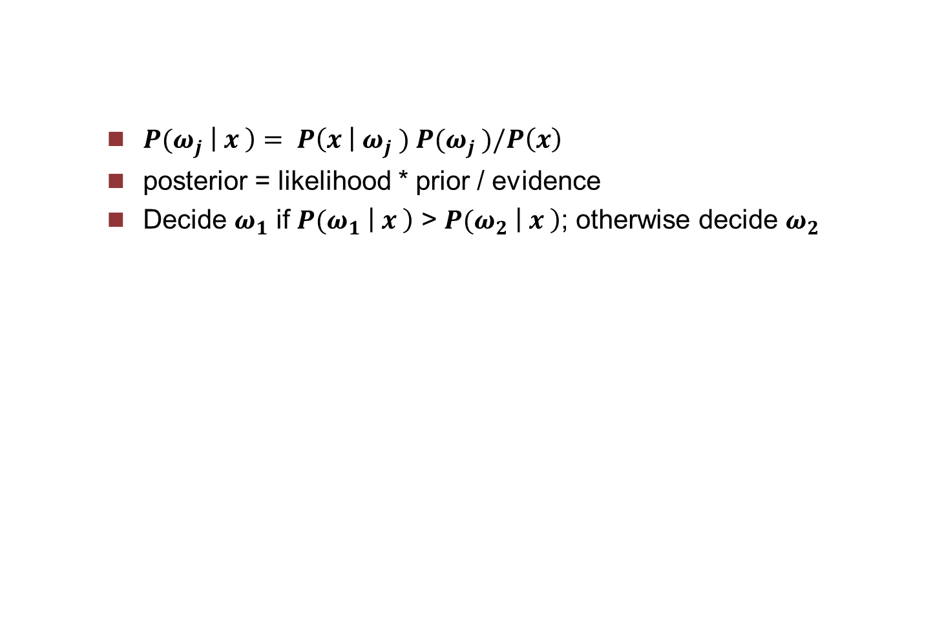
Bayesian decision
${P(ω}_{j} \left| x \right)= {P\left(x \right| ω}_{j} ){ P(ω}_{j} )/P\left(x\right)$
posterior = likelihood * prior / evidence
Decide $ω_{1}$ if ${P(ω}_{1} \left| x \right)$ > ${P(ω}_{2} \left| x \right)$; otherwise decide $ω_{2}$
Notes:
Now the big trends in visual computing are …

Slide 109
Statistical measurements
Precision
Recall
coverage
Notes:
Now the big trends in visual computing are …

Slide 110
Reinforcement learning (RL)
Dynamic programming uses a mathematical model of the environment, which is typically formulated as a Markov Decision Process
The main difference between the classical dynamic programming and RL is that RL does not assume an exact mathematical model of the Markov Decision Process, and target large MDP where exact methods become infeasible
Therefore, RL is neuro dynamic programming. In operational research and control, it’s called approximate dynamic programming

Slide 111
Non-linear iterative optimisation
J d = r from vector F(x+d)=F(x)+J d
minimize the square of y-F(x+d)=y-F(x)-J d = r – J d
normal equation is J^T J d = J^T r (Gauss-Newton)
(H+lambda I) d = J^T r (LM)
Note: F is a vector of functions, i.e. min f=(y-F)^T(y-F)
Notes:
this means: g is gradient vector, H is the hessian matrix
jocobien is for squared model, r^T r …

Slide 112
General non-linear optimisation
1-order , d gradient descent d= g and H =I
2-order,
Newton step: H d = -g
Gauss-Newton for LS: f=(y-F)^T(y-F), H=J^TJ, g=-J^T r
‘restricted step’, trust-region, LM: (H+lambda W) d = -g
R. Fletcher: practical method of optimisation
f(x+d) = f(x)+g^T d + ½ d^T H d
Note: f is a scalar valued function here.
Notes:
this means: g is gradient vector, H is the hessian matrix
jocobien is for squared model, r^T r …

Slide 113
statistics
‘small errors’ --- classical estimation theory
analytical based on first order appoxi.
Monte Carlo
‘big errors’ --- robust stat.
RANSAC
LMS
M-estimators
Talk about it later

Slide 114
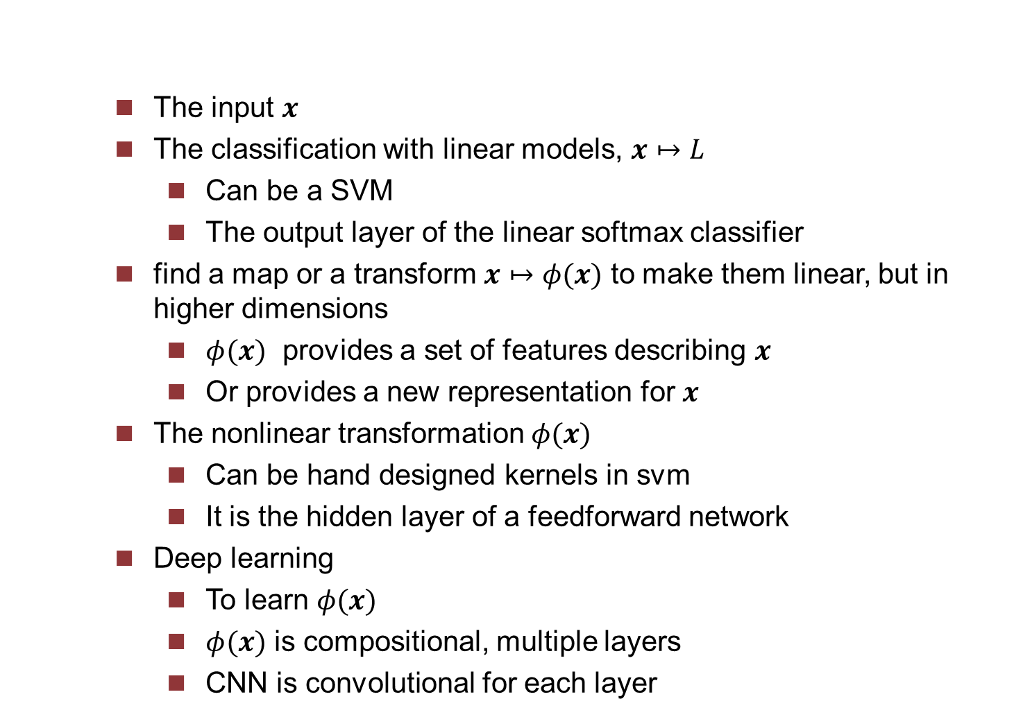
An abstract view
The input $x$
The classification with linear models, $x↦L$
Can be a SVM
The output layer of the linear softmax classifier
find a map or a transform $x↦φ(x)$ to make them linear, but in higher dimensions
$φ(x)$ provides a set of features describing $x$
Or provides a new representation for $x$
The nonlinear transformation $φ(x)$
Can be hand designed kernels in svm
It is the hidden layer of a feedforward network
Deep learning
To learn $φ(x)$
$φ(x)$ is compositional, multiple layers
CNN is convolutional for each layer
Notes:
They admit simple algorithms where the form of the nonlinearity can be learned from the training data.
They are extremely powerful, have nice theoretical properties, apply well to a vast array of applications.

Slide 115
To do
Add drawing for ‘receptive fields’
Dot product for vectors, convolution, more specific for 2D? Time invariant, or translation invariant, equivariant
Convolution, then nonlinear acitivation, also called ‘detection stage’, detector
Pooling is for efficiency, down-sampling, and handling inputs of variable sizes,

Slide 116
Cost or loss functions - bis
Classification and regression are different! for different application communities
We used more traditional regression, but the modern one is more on classification, so resulting different loss considerations
Regression is harder to optimize, while classification is easier, and more stable
Classification is easier than regression, so always discretize and quantize the output, and convert them into classification tasks!
One big improvement in NN modern development is that the cross-entropy dominates the mean squred error L2, as the mean squared error was popular and good for regression, but not that good for NN. because of its fundamental more appropriate distribution assumption, not normal distributions
L2 for regression is harder to optimize than the more stable softmax for classification
L2 is also less robust

Slide 117
Automatic differentiation (algorithmic diff), and backprop, its role in the development
Differentiation: symbolic or numerical (finite differences)
Automatic differentiation is to compute derivatives algorithmically, backprop is only one approach to it.
Its history is related to that of NN and deep learning
Worked for traditional small systems, a f(x)
Larger and more explicit composional nature of f1(f2(f3(… fn(x)))) goes back to the very nature of the derivatives
Forward mode and reverse mode (it is based on f(a+b epsilon) =f(a)+f’(a)b epsilon, f(g(a+b epsilon) = f(g(a))+f’(g(a))g’(a) b epsilon)
The reverse mode is backprop for NN
In the end, it benefits as well the classical large optimization such as bundle adjustment
Notes:
Thru cs231n, https://arxiv.org/abs/1502.05767, https://arxiv.org/abs/1502.05767

Slide 118
Viewing the composition of an arbitrary function as a natural layering
Take f(x,y)=x+s(y) / s(x) + (x+y)^2, at a given point x=3,y=-4
Forward pass
f1=s(y), f2 = x+f1, f3=s(x), f4=x+y, f5=f4^2, f6=f3+f5, f7=1/f6, f8=f2*f7
So f(*)=f8(f7(f6(f5(f4(f3(f2(f1(*)))))))), each of fn is a known elementary function or operation
Backprop to get (df/dx, df/dy), or abreviated as (dx,dy), at (3,-4)
f8=f, abreviate df/df7 or df8/df7 as df7, df/df7=f2,…, and df/dx as dx, …
df7=f2, (df2=f7), df6= (-1/f6^2) * df7, df5=df6, (df3=df6), df4=(2*f4)df5, dx=df4, dy=df4, dx += (1-s(x)*s(x)*df3 (backprop in s(x)=f3), dx += df2 (backprop in f2), dy += df2 (backprop in f2), dy += (1-s(y))*s(y)*df1 (backprop in s(y)=f1)
In NN, there are just more variables in each layer, but the elementary functions are much simpler: add, multiply, and max.
Even the primitive function in each layer takes also the simplest one! Then just a lot of them!
Notes:
See Stanford cs231n python example

Slide 119
Computational graph
NN is described with a relatively informal graph language
More precise computational graph to describe the backprop algorithms
Notes:
http://www.ams.org/publicoutreach/feature-column/fc-2017-12

Slide 120
Structured probabilistic models, Graphical models, and factor graph
A structured probabilistic model is a way of describing a probability distribution.
Structured probabilistic models are referred to as graphical models
Factor graphs are another way of drawing undirected models that resolve an ambiguity in the graphical representation of standard undirected model syntax.

